Slide 1
Program control flow
Sequence
Selection/Decision
Iteration/looping

Slide 2
Control Flow
Decision making is required when we want to execute a code only if a certain condition is satisfied.
The if…elif…else statement is used in Python for decision making.
if x expression:
statement(s)
Start
Test
False
True
Body of If

Slide 3
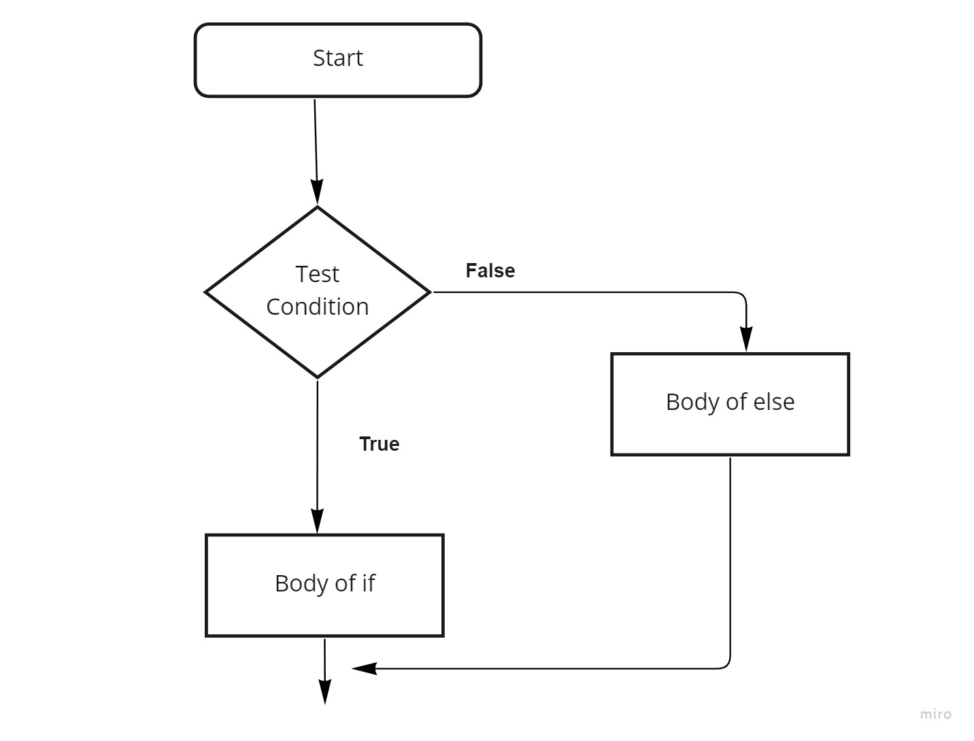
Python if...else Statement

Slide 4
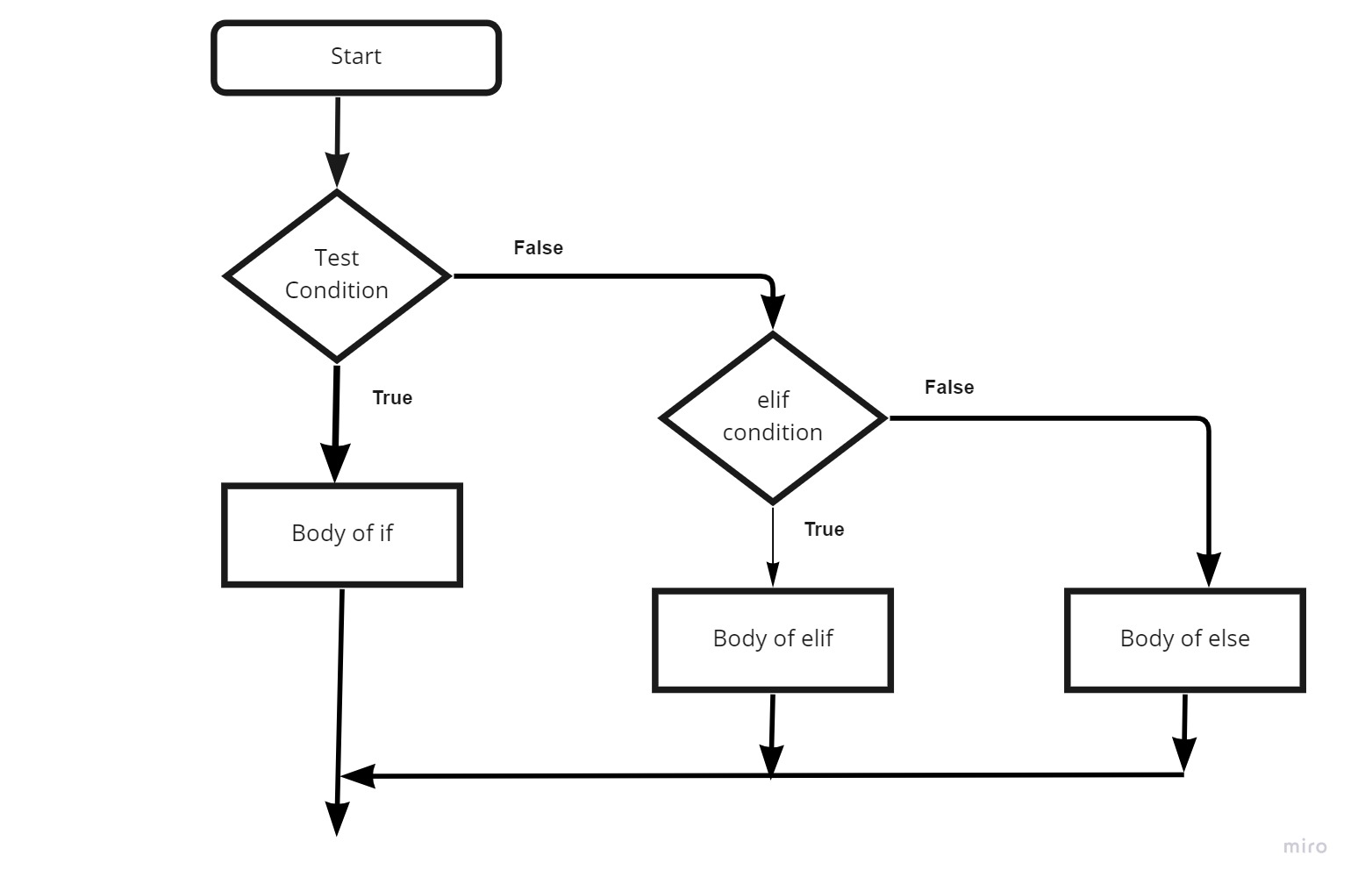
Flowchart of if...elif...else

Slide 5
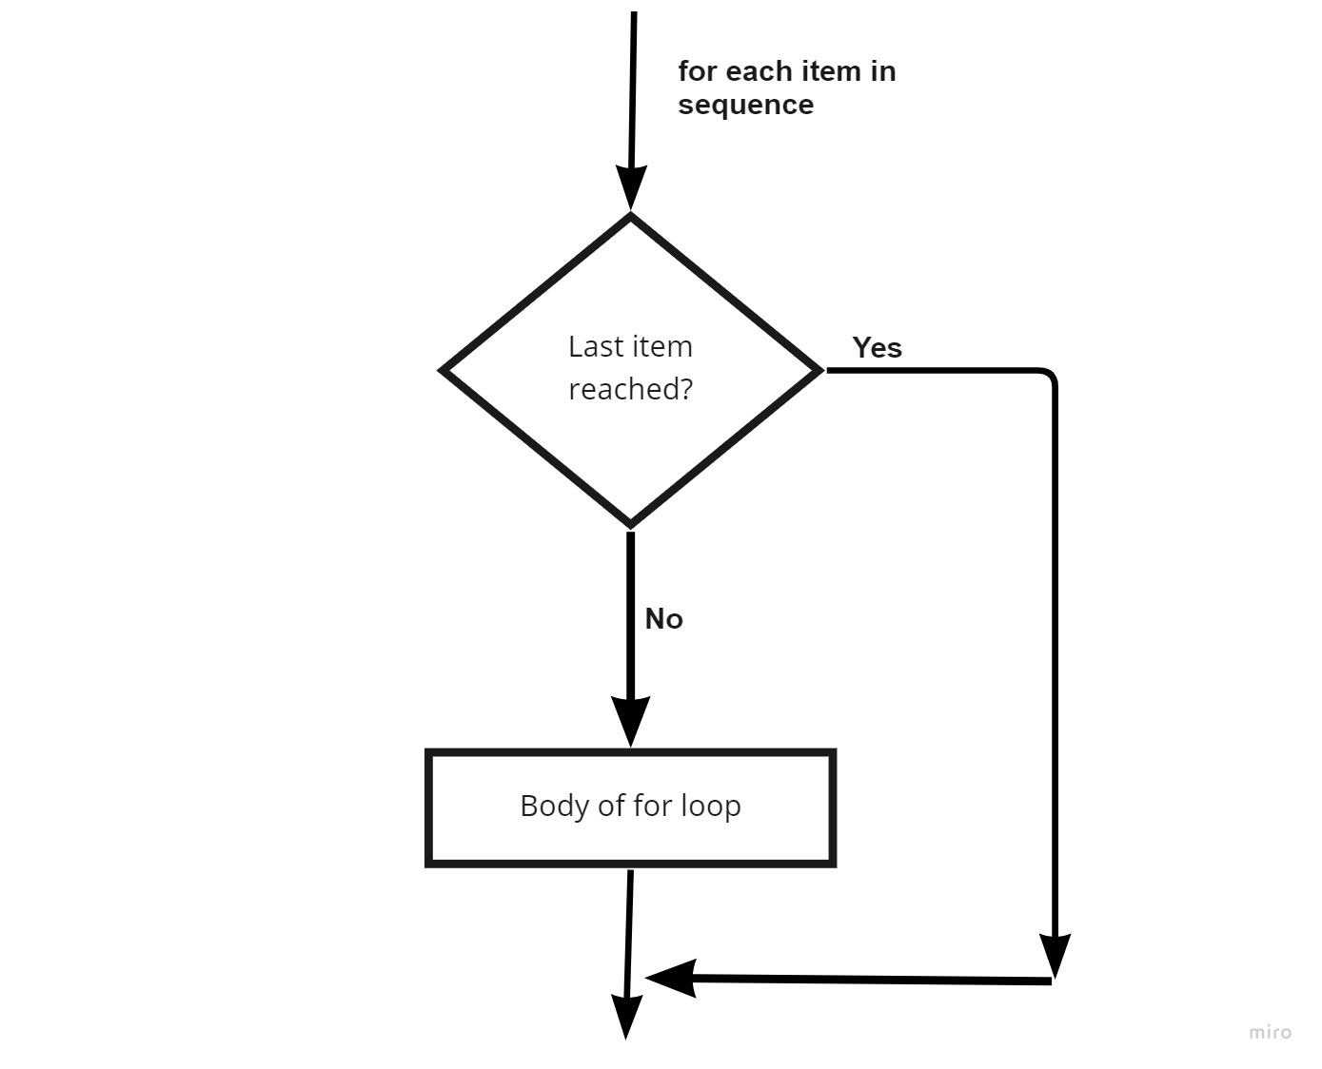
For Loop
The for loop in Python is used to iterate over a sequence

Slide 6
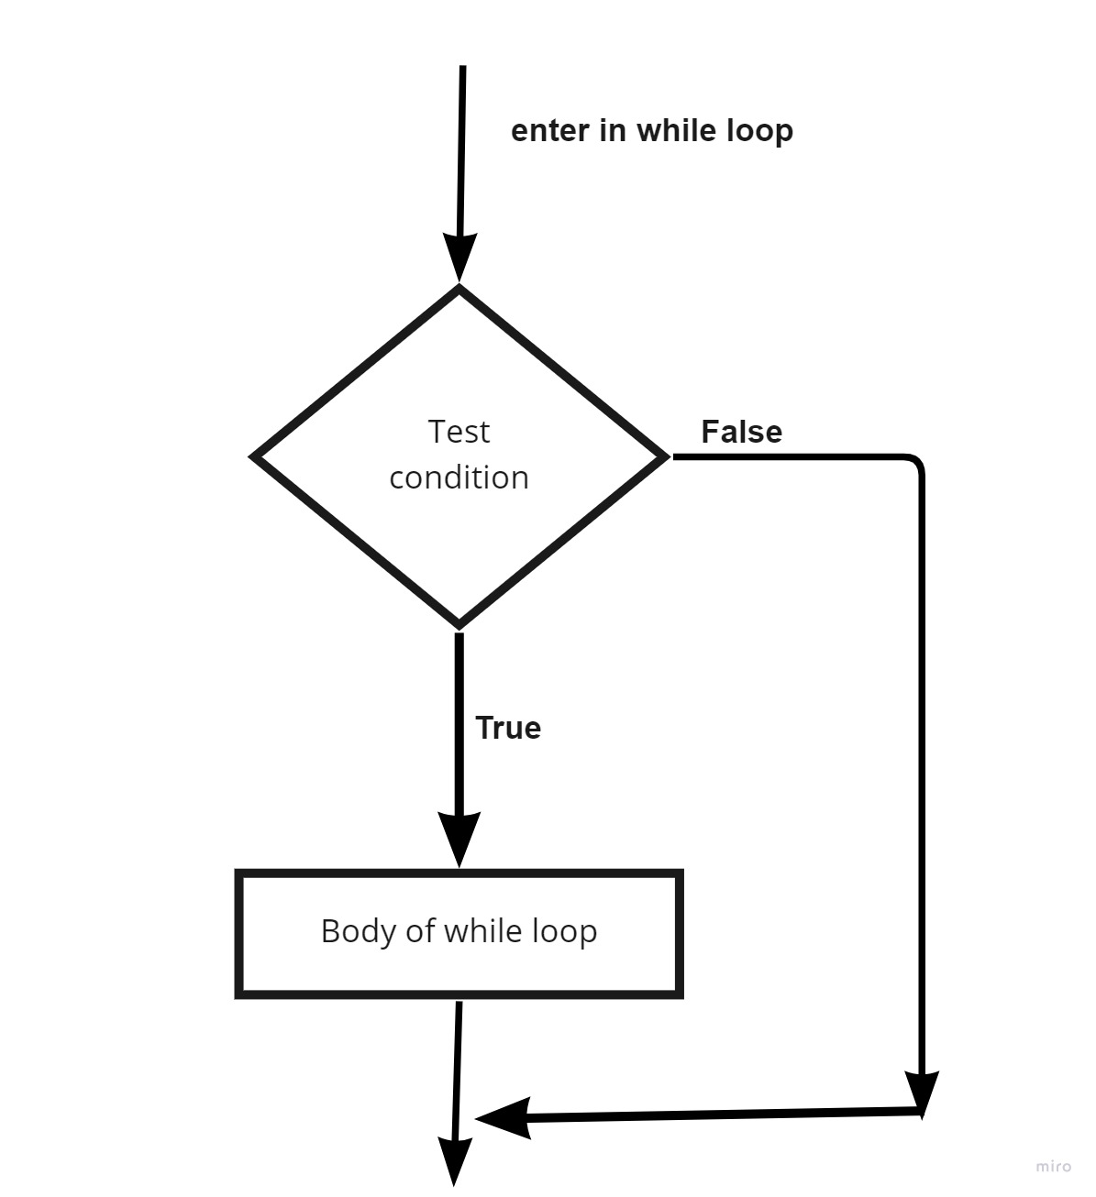
While Loop
The while loop in Python is used to iterate over a block of code as long as the test expression (condition) is true

Slide 7
Jump Statements
Break
Continue

Slide 8
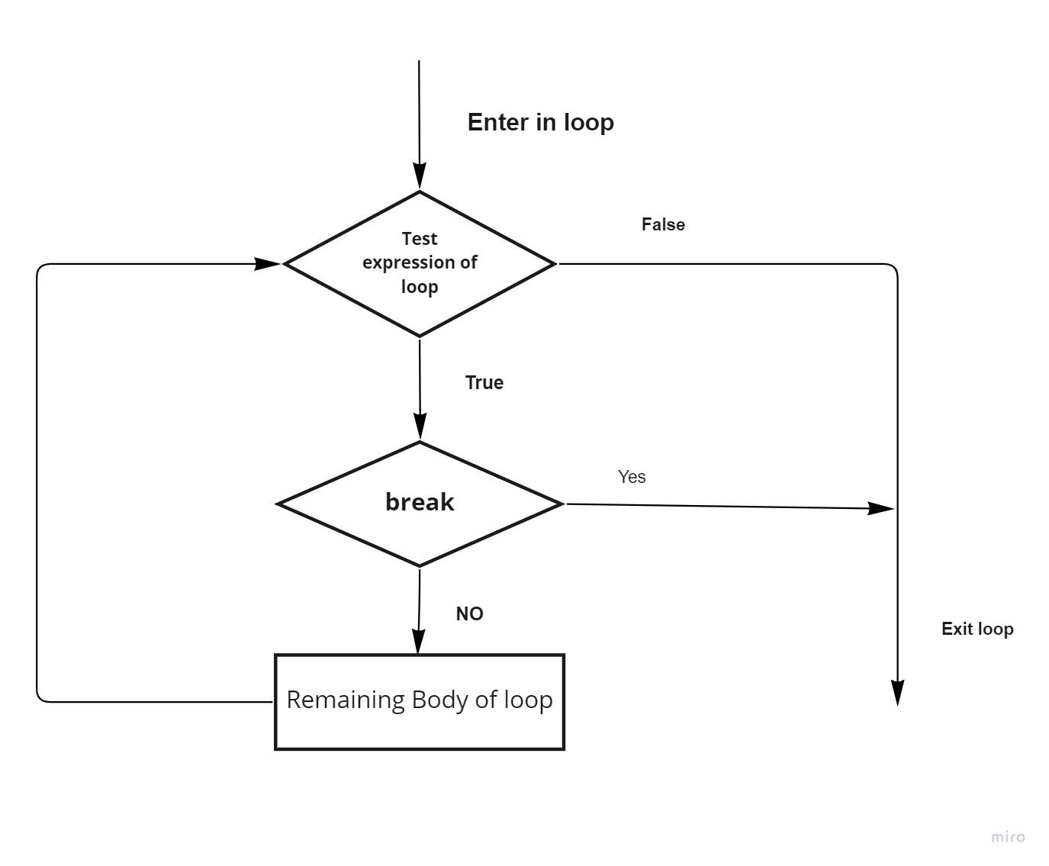
Break Statement
The break statement terminates the current loop & resumes execution at the next statement immediately after the end of that loop.
If break is inside the nested loop, innermost loop will be terminated.

Slide 9
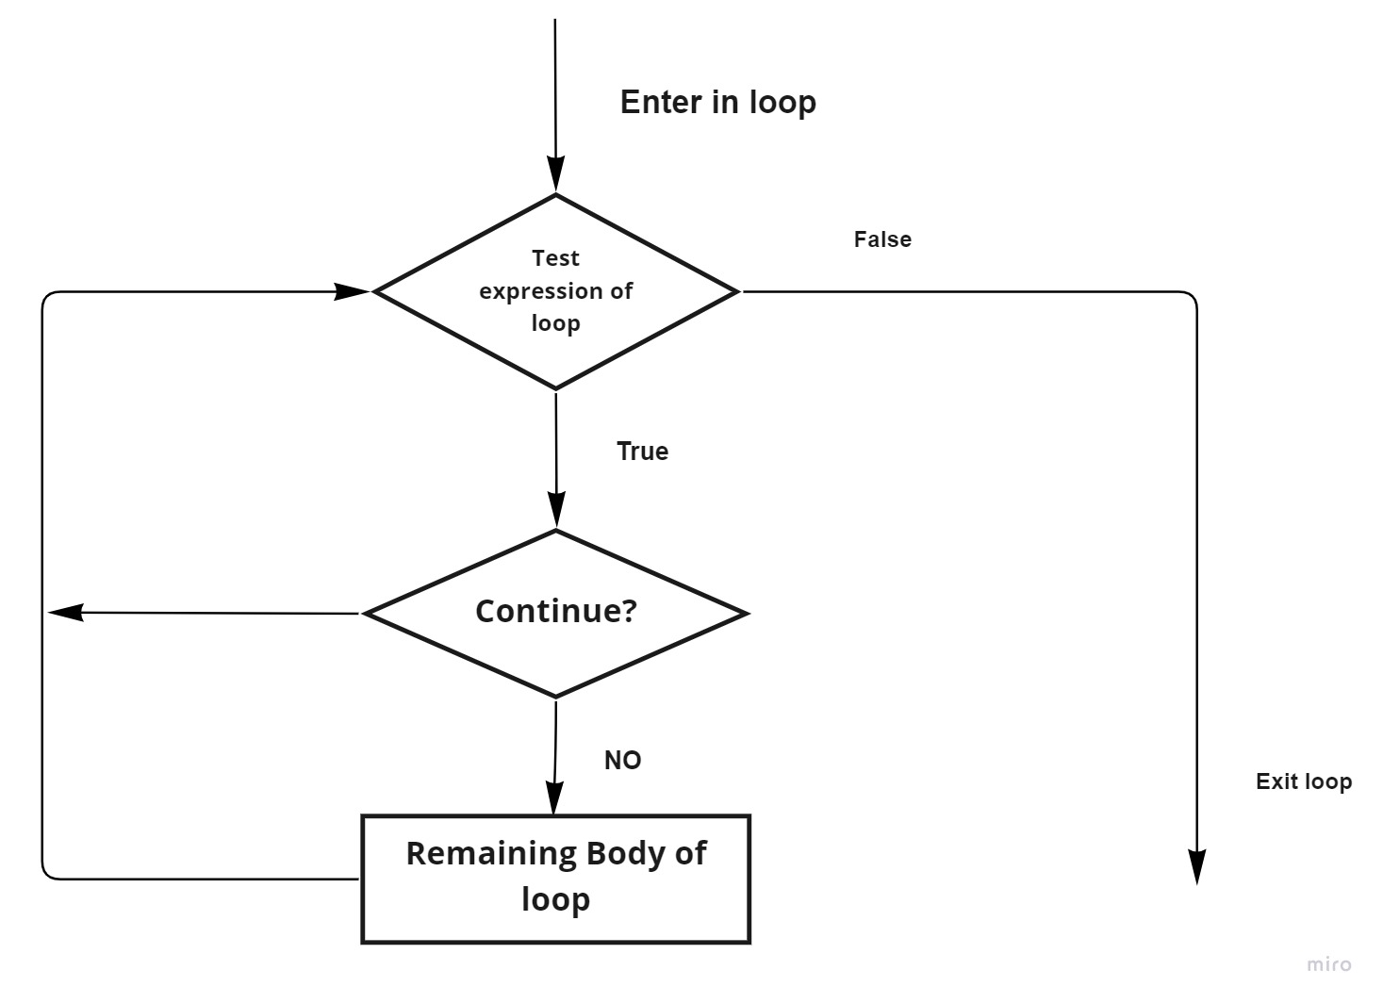
Continue Statement
When the continue statement is encountered, the control jump to the beginning of the loop the next iteration.

Slide 10
Thank You

